Slide 1


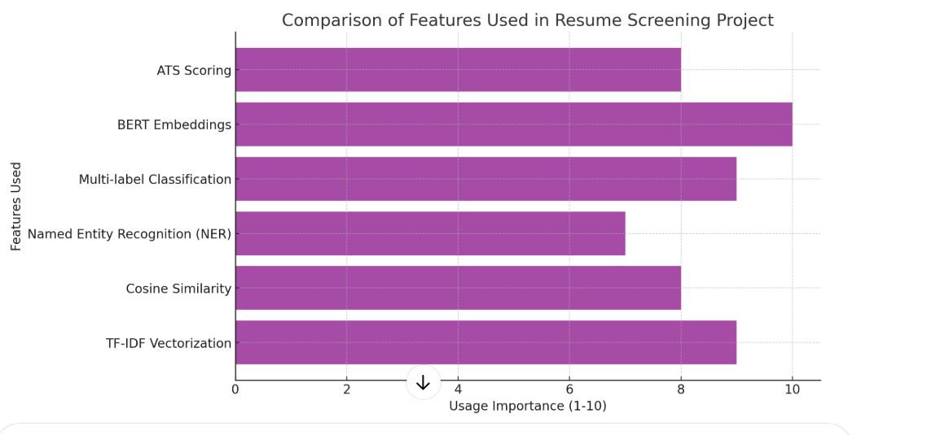

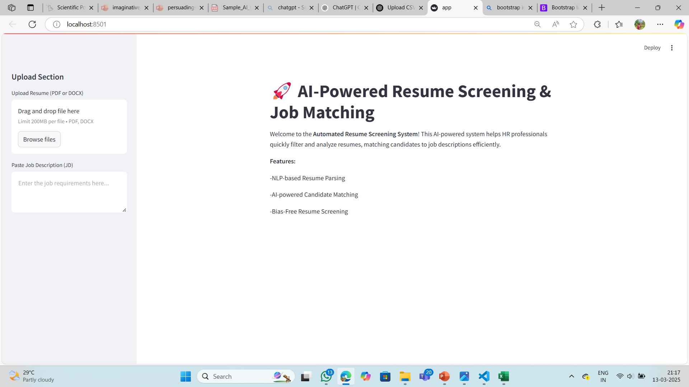
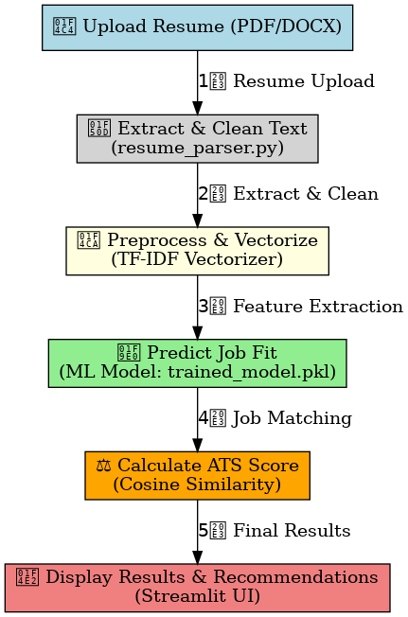
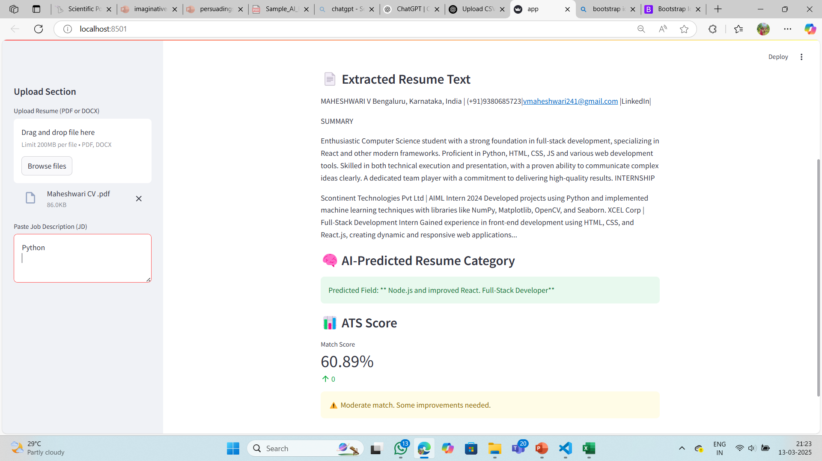
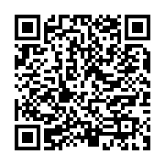
DON BOSCO INSTITUTE OF TECHNOLOGY
DEPARTMENT OF COMPUTER SCIENCE AND ENGINEERING
UNDER DBIT-SIC
Automated Resume Screening System
Manual resume screening is time-consuming, inconsistent, and prone to bias. Recruiters struggle to process large volumes, leading to inefficiencies. This project automates screening using AI and NLP, extracting key details, classifying resumes, and matching them to job roles using TF-IDF and Cosine Similarity. The system ensures faster, unbiased, and accurate hiring.)
PREDICTION MODEL
PROBLEM STATEMENT
RESPONSE DISPLAY
s
COMPARISION FEATURE
The system utilizes Machine Learning (ML) and NLP
ML Model (trained_model.pkl) – Trained using Random Forest.
Text Processing (tfidf_vectorizer.pkl) Extracts relevant skills and job-related terms.
ATS Score Calculation – Uses Cosine Similarity to rank resumes using dot product.
The system displays results in the Streamlit UI (app.py) with the following output:
Extracted Resume Text – Parsed text from uploaded PDF/DOCX resumes, AI extracts text and analyzes skills.
Job Matching Score (ATS Score) – A percentage-based score (0-100%) calculated using Cosine Similarity.
Top Matched Job Roles – Categories assigned based on ML model (trained_model.pkl).
DATASETS
USER INTERFACE
CONCLUSION
The dataset includes resume text and job descriptions for AI-based screening.Resume Dataset (resume_data.csv) Contains resumes categorized by job roles.
The AI-powered resume screening system automates resume parsing, job matching, and candidate evaluation using machine learning and NLP. It reduces screening time by 75%, improves hiring accuracy, and ensures unbiased, data-driven selection. The system is scalable and efficient, making recruitment faster and fairer. Future improvements may include real-time job analysis and AI-driven interview recommendations.
ANALYSIS
PROJECT SOURCE CODE
S BALAKRISHNA-1DB21CI076 SOWMYA J S-1DB21CS146

